Slide 1

STOCK MARKET PREDICTION

Slide 2
INTRODUCTION
MODELLING AND FORECASTING FINANCIAL MARKET
FINANCIAL COMMODITIES – STOCKS, BONDS, ETC.,
SIGNAL PROCESSING PROBLEM
HIGH NOISE
SMALL SAMPLE SIZE
NON-STATIONARITY
NON-LINEARITY

Slide 3
EFFICIENT MARKET HYPOTHESIS:
BURTON’S HYPOTHESIS
PREDICTION & FORECASTING IS UNREALISTIC
CHANGES ARE BASED ON THE IMMEDIATE ECONOMIC EVENTS
NO PROOF – PROPER OR NOT
YASUR
PREDICTABLE TO SOME EXTENT
PAST EXPERIENCE OF PRICE CHANGES & FIXED SERIAL CORRELATIONS

Slide 4
STATISTICAL MODELS
MACHINE LEARNING TECHNIQUES
MULTI-LAYER FEED FORWARD NN, SVM, REINFORCEMENT LEARNING, RVM AND RNN
NEURAL NETWORKS
LEARNS FROM EXAMPLES BY CONSTRUCTING INPUT → OUTPUT MAPPING
NON-PARAMETRIC STATISTICAL INFERENCE
MORE NOISE TOLERANT AND FLEXIBLE
LSTM
FOR TIME SERIES DATA
HANDLE NOISE , DISTRIBUTED REPRESENTATION AND CONTINUOUS VALUES

Slide 5
RECURRENT NEURAL NETWORKS

Slide 6
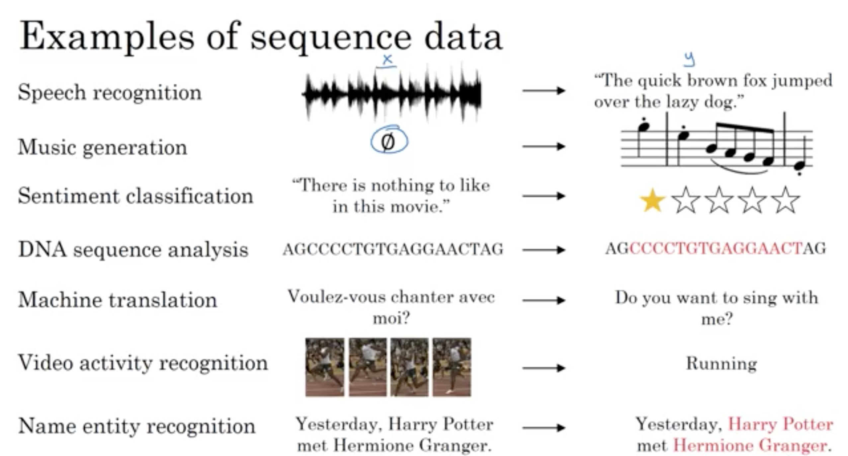

Slide 7
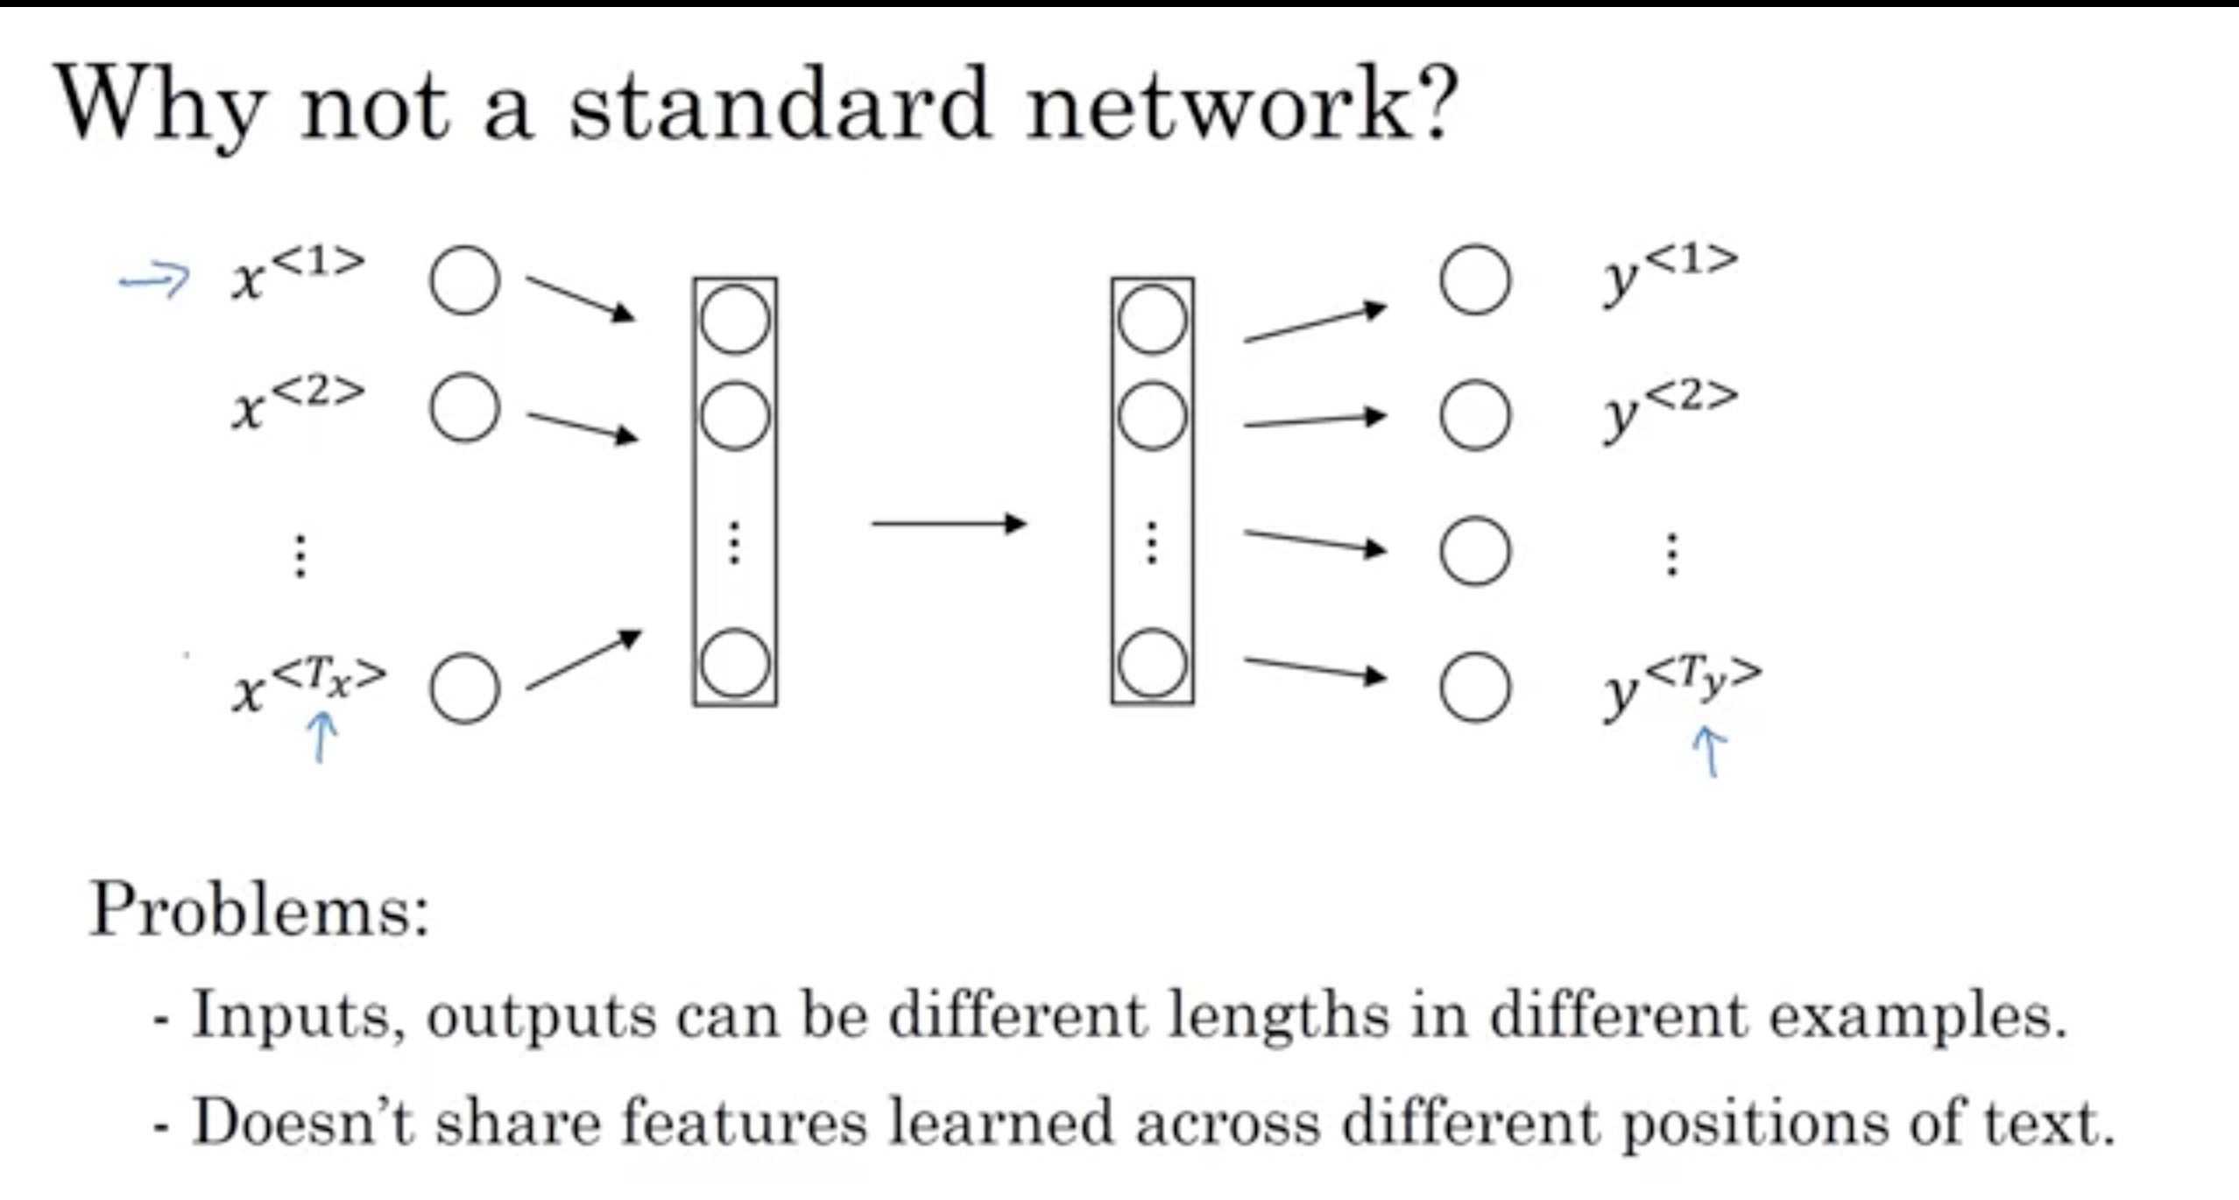

Slide 8
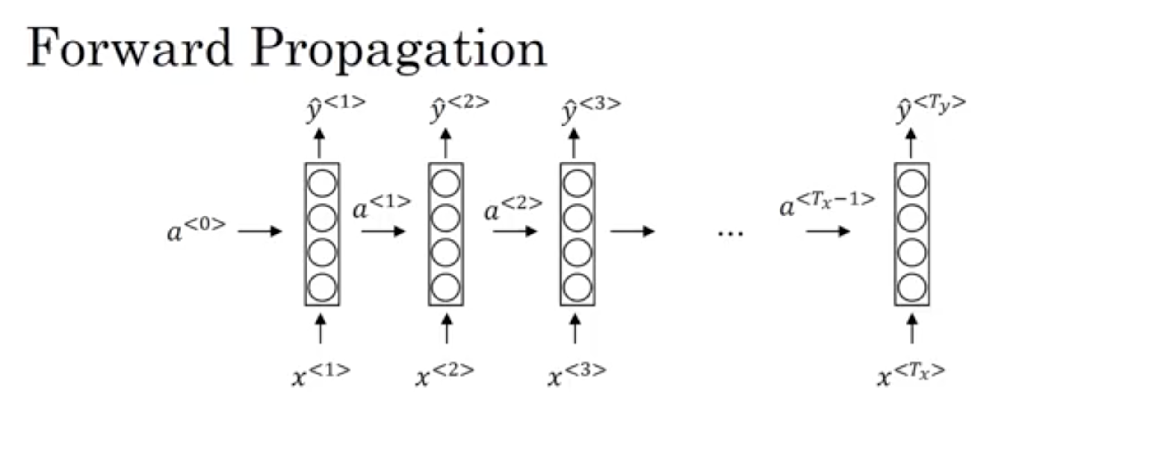
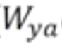
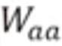
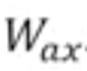
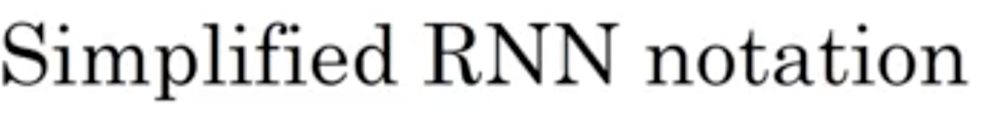
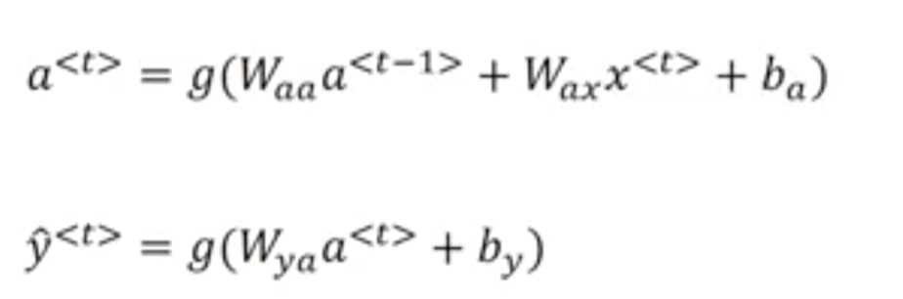
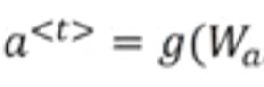
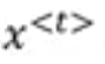
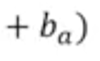
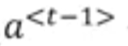
[
,
]

Slide 9
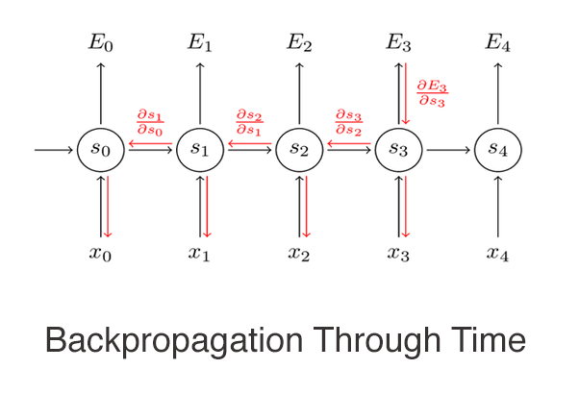
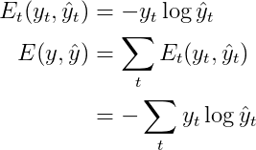
Backpropagation Through Time

Slide 10
Problems in RNN

Slide 11
RNN Example:-
Cat, who ate lots of bananas , milk and fish is full now.
Cats, who ate lots of bananas , milk and fish are full now.
Long term dependency

Slide 12
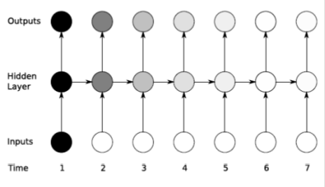
Problems in Deep Neural Network
Y^{<1>}
Y^{<2>}
Y^{<Ty>}
X^{<1>}
X^{<2>}
X^{<Tx>}

Slide 13
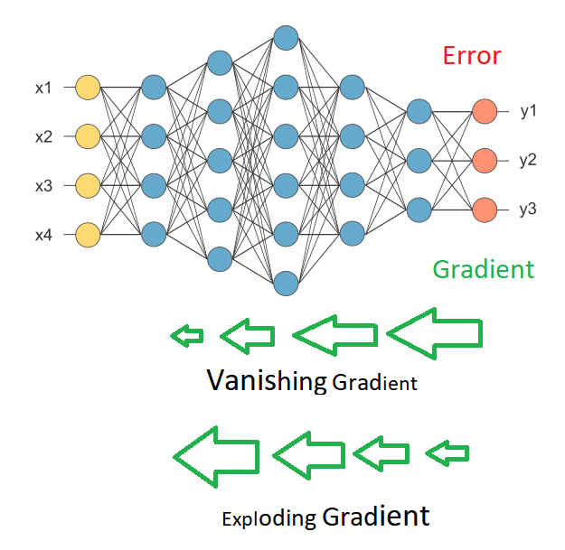

Slide 14

Vanishing & Exploding Gradient Problem in RNN
W = Small => Vanishing Gradient Problem
W = Big => Exploding Gradient Problem

Slide 15
Solutions
Exploding Gradient Problem
→Gradient Clipping
Vanishing Gradient Problem
→GRU
→LSTM

Slide 16
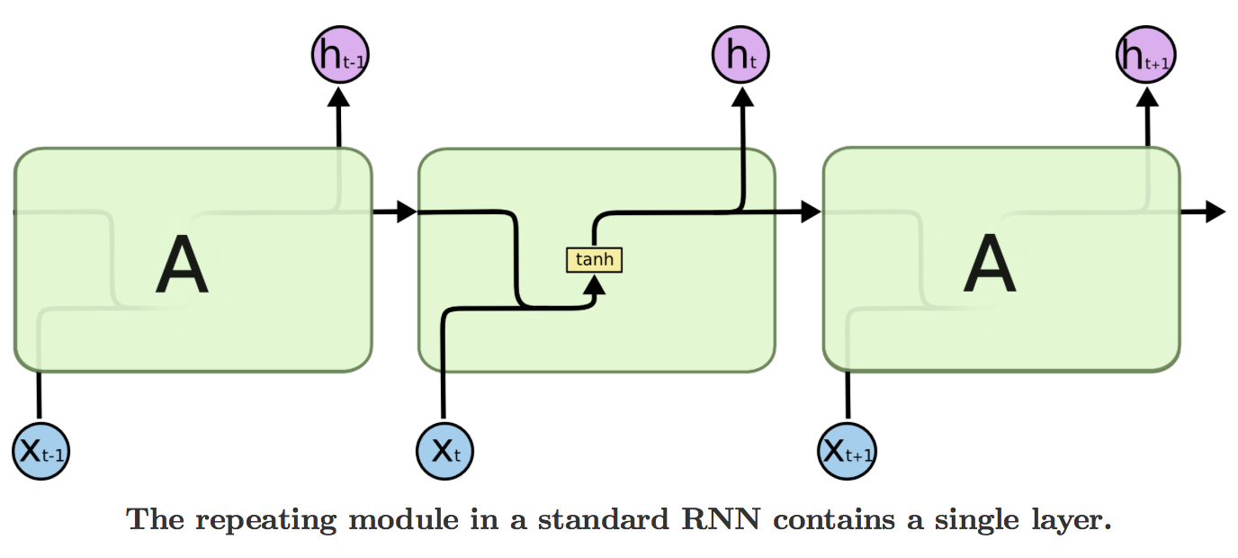
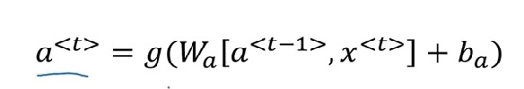
Hidden Layer of RNN
Softmax
a_{t-1}
a_{t}

Slide 17
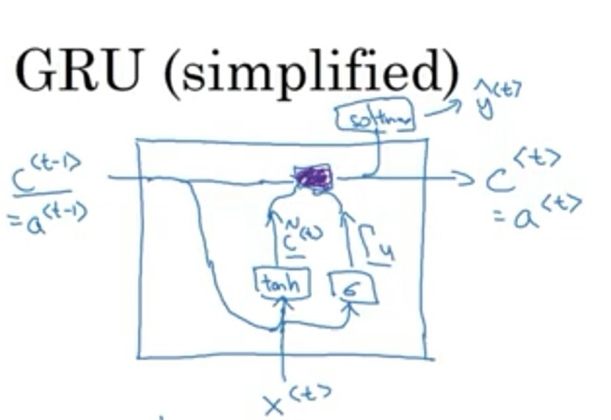

Slide 18
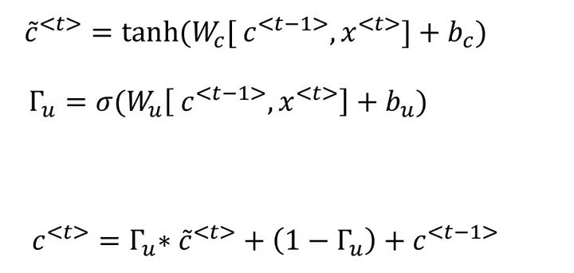
Simplified GRU Equations:

Slide 19
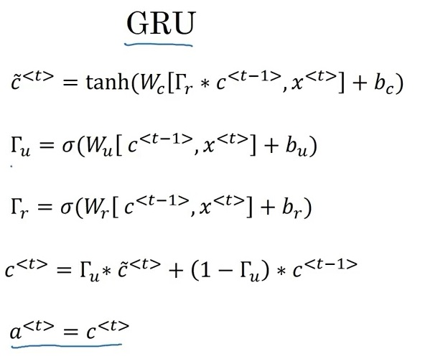
FULL

Slide 20
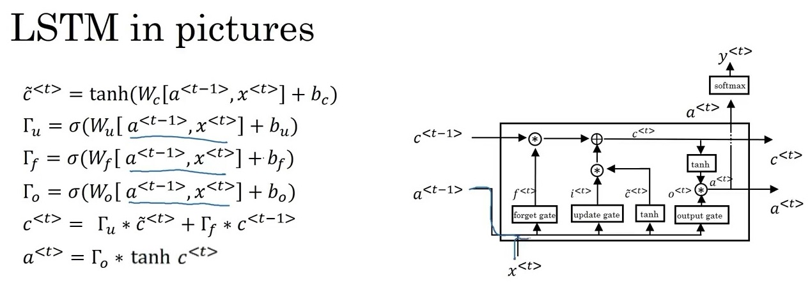

Slide 21
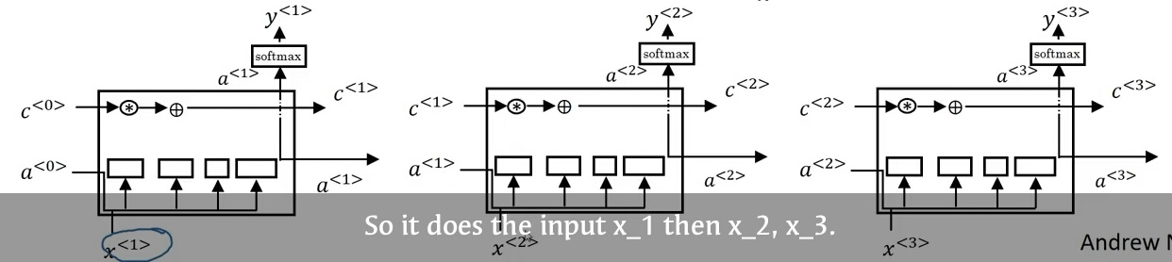
LSTM

Slide 22
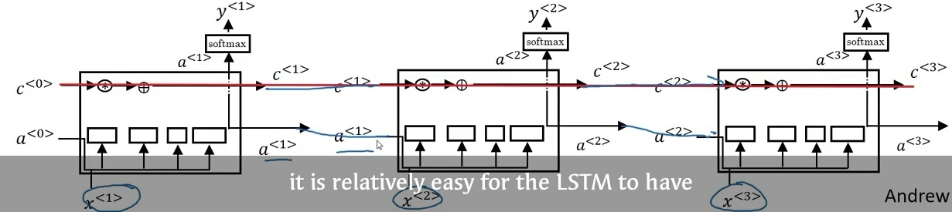
LSTM

Slide 23
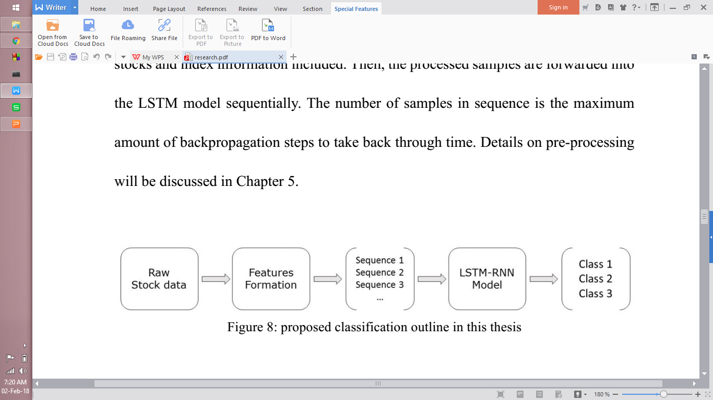
PROPOSED MODEL

Slide 24
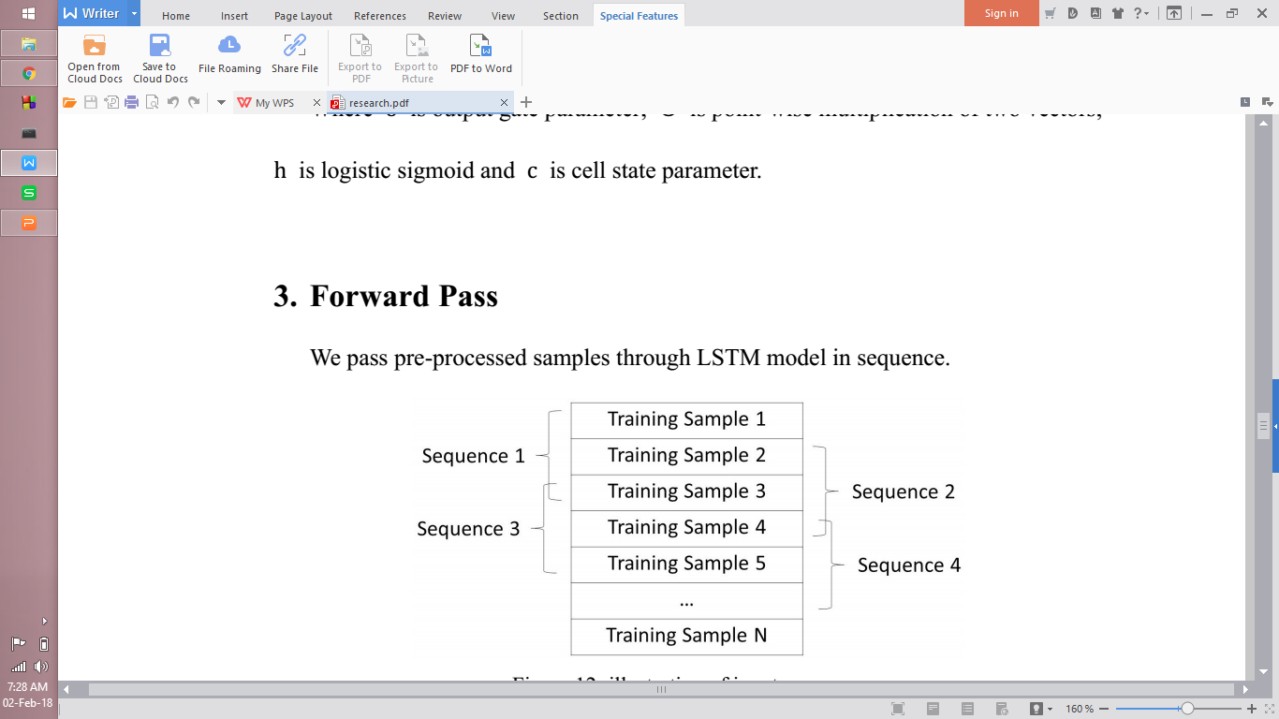
INPUT SEQUENCE

Slide 25
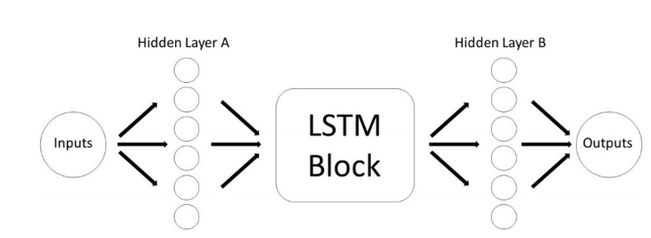
LSTM - RNN MODEL

Slide 26
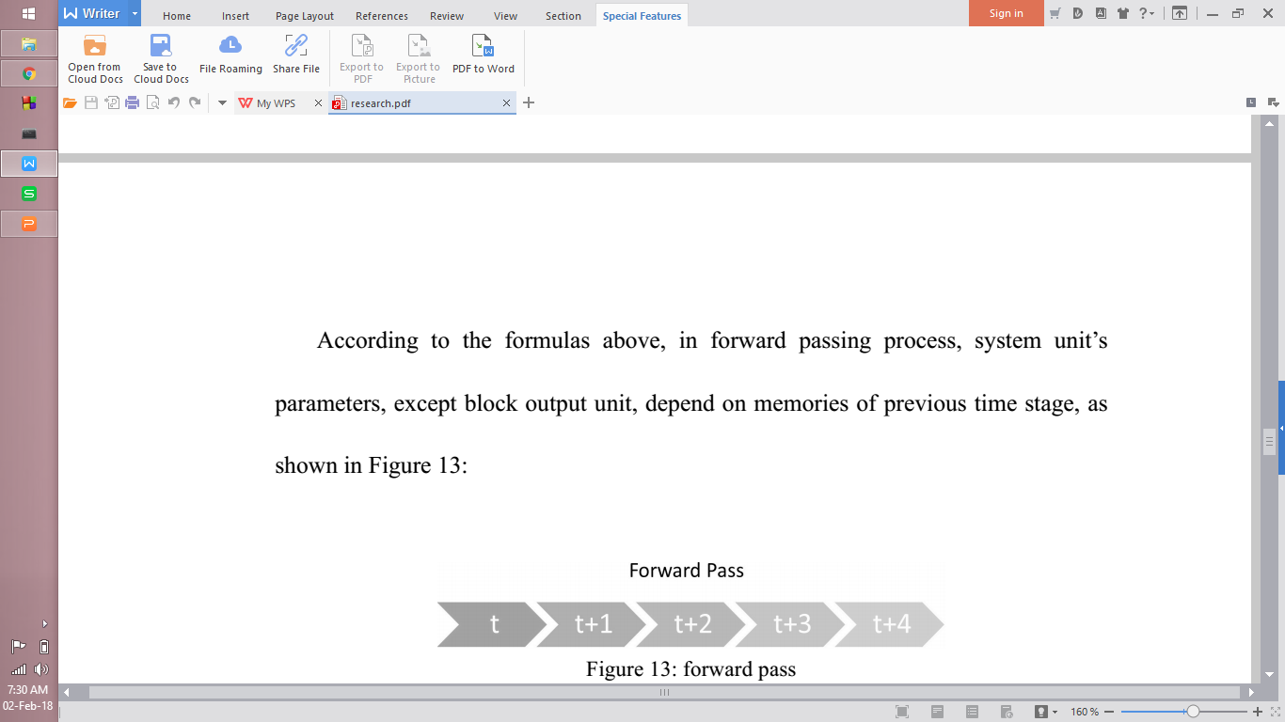
FORWARD PASS

Slide 27
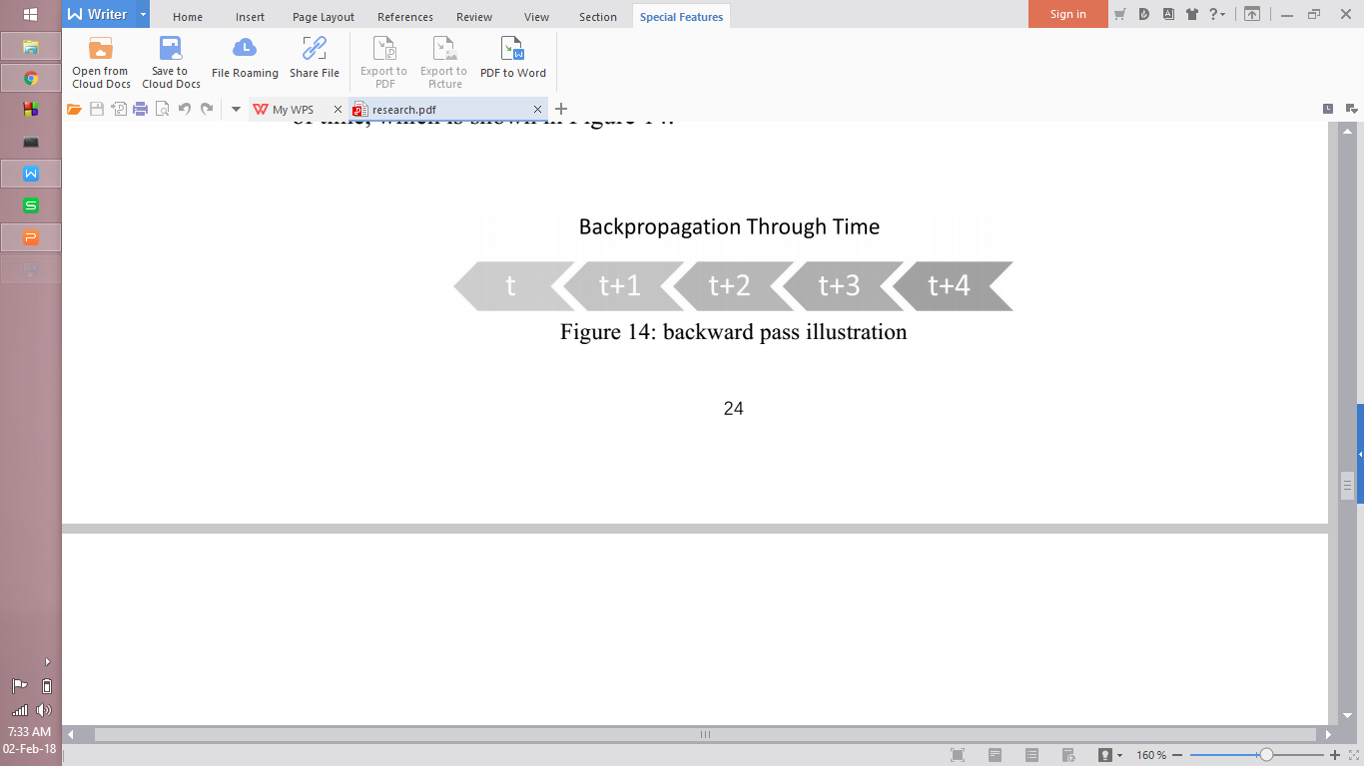
BACKWARD PROPAGATION

Slide 28

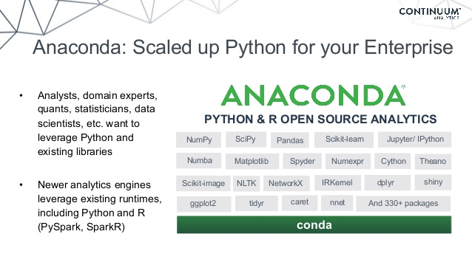





SOFTWARE REQUIREMENTS

Slide 29

HARDWARE REQUIREMENTS

Slide 30
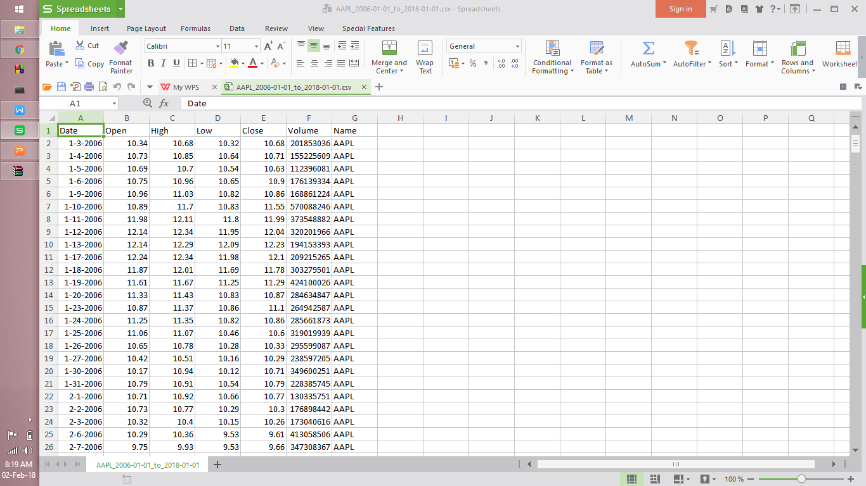
DATA SET

